Slide 1


Sandia Insights – A Data Sciences Architecture and Framework
National Laboratories Information Technology (NLIT) 2022
October 17, 2022
Dr. Patrick Carlson - Sandia National Lab
Dr. Ian Brooks – Cloudera Government
SAND2022-13719 C

Slide 2

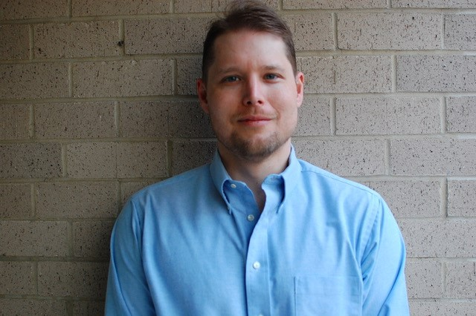
Presenters
Dr. Patrick Carlson
Dr. Ian Brooks
PhD graduate in Human-Computer Interaction (HCI) from Iowa State University
Worked at Sandia National Labs as a Data Scientist since 2017
Leads the Sandia Data Sciences Community of Practice (CoP)
Interested in the technical aspects of Data Science such as data engineering, programming, analysis, modeling, machine learning, productionization, ml-ops, data-ops, and more
PhD graduate in Computer Science from the University of North Texas
Focused on Big Data solutions since 2015
Previous industry roles include Software Engineer, Data Architect, and Data Scientist
At Cloudera, he is a Principal Solutions Engineer on the Public Sector team and a Machine Learning SME

Slide 3




Why Sandia Insights
Reduce duplication and rework
Faster turnaround time
Data Scientists and Data Engineers
Data Governance
Leadership
Rapid access to data
Robust tooling
Common environment with libraries preinstalled
HPC and model training
Data security
Centralized access controls
Central data catalog management
Data-driven decision making

Slide 4
Vision for Sandia Insights
Empower Data Scientists and Analysts through easy access to vetted enterprise datasets
Secure and document data through Data Governance and a data catalog
Productionize and operationalize models, use data-ops and ml-ops practices
Build out a pipeline and best practices for the entire data-lifecycle
Focus on people and methods, not specific tools

Slide 5



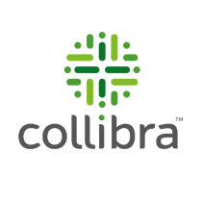
History of Sandia Insights
2015 – Tableau Server
2016 – Analytics for Sandia Knowledge (ASK)
Custom developed catalog
Tableau visualizations and reports
Vetted enterprise datasets via Data Central
Expertise finder and co-author network
2018 – CKAN data catalog
2018 – RStudio Connect (previously called Shiny Server)
2019 – Cloudera installation
2020 – Collibra data catalog

Slide 6
Current State

Slide 7

Data Lifecycle

Slide 8
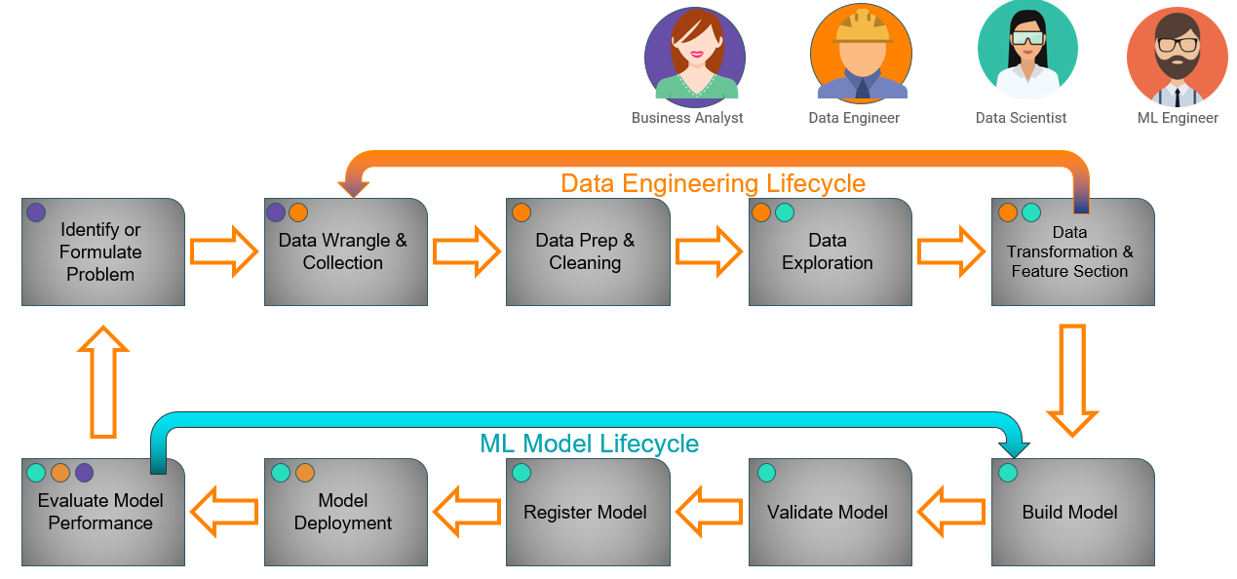
Advanced Analytics Data Lifecycle
Notes:
People and expertise matter more than IT tooling and software. The delineation of roles and expertise as part of the data lifecycle is exceedingly important. Don’t assume hiring a Data Scientist will mean they can do everything well unless you hire a unicorn! This is a feedback loop.

Slide 9
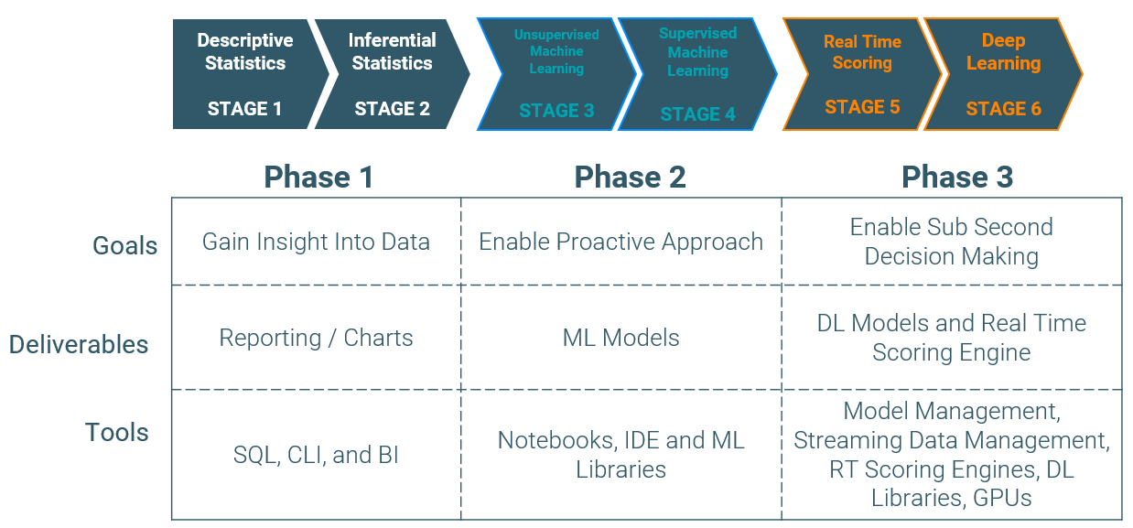
Progression of Enterprise Data Science Practices
Notes:
Sandia is currently starting phase 2. Progression of maturity.

Slide 10
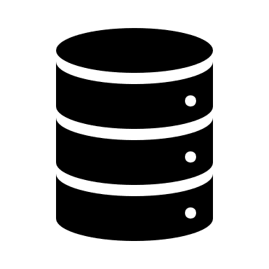
Current Data Pipeline
Source Data
Operational Databases
ETL
Managed Warehouses
Denodo Data Virtualization
Security and Access Controls
Reporting, Analytics, Modeling
Cloudera Data Platform
Notes:
Mostly focused today on structured and semi-structured datasets.

Slide 11
Challenges
Existing legacy ETL process
Batch ETL process is well suited for slowly changing datasets or tables (once a week updates)
Batch ETL process ties up system for many hours, prevents usage of data for reporting and analytics
Existing process is rigid and prevents agile development

Slide 12
Future State

Slide 13
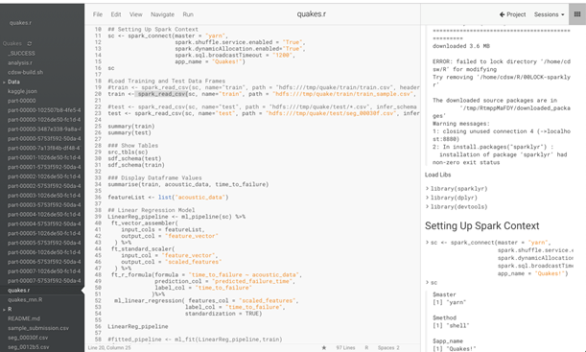



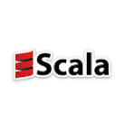

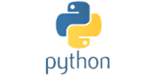
Productionization of Data Science and Collaboration
ml-ops – productionizing machine learning applications
Cloudera Data Science Workbench (CDSW) – containerized environment for Data Scientists, collaborative development
Future MLFlow support for experiment tracking and hyper-parameter tuning

Slide 14

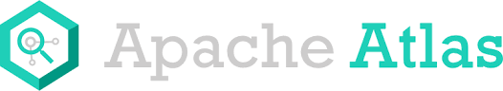

Data Governance and Cataloging
Document more datasets with descriptions and metadata
Leverage Denodo as singular integration point for structured data and access controls
Tagging data in Denodo and Cloudera (Apache Atlas)
Test attribute-based access controls in Denodo and Cloudera (Apache Ranger)
Working on labels and sensitivity categories to address Controlled Unclassified Information (CUI) requirements

Slide 15

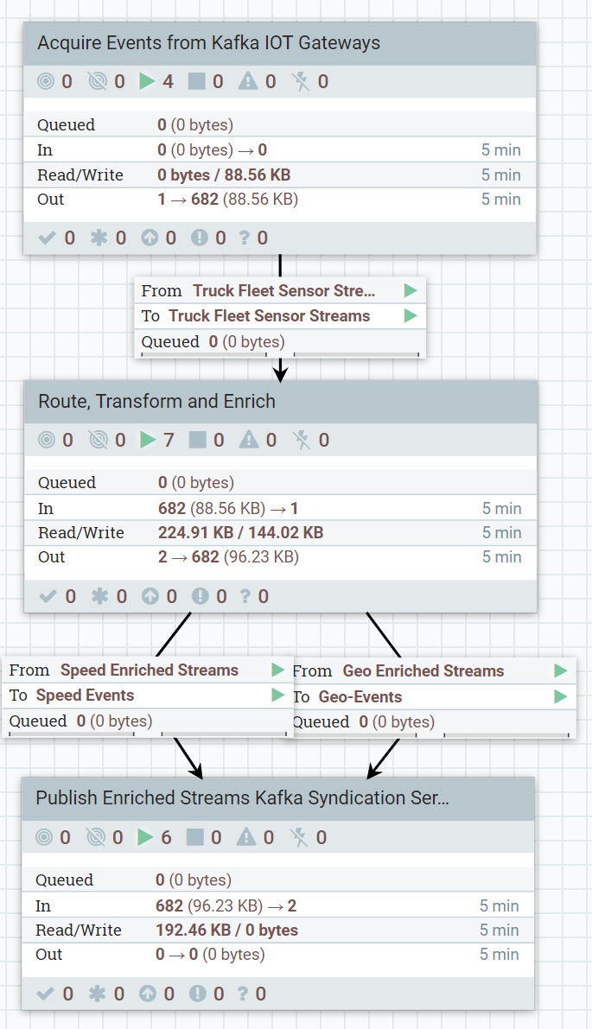



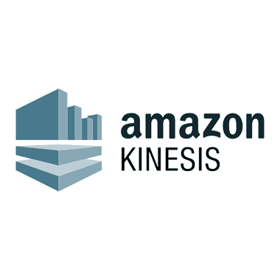
Change Data Capture (CDC)
OPTION 1
APACHE KAFKA
Buffer
APACHE NIFI
Enrich
DATA-AT-REST
Store
SOURCE DBMS
CHANGE DATA CAPTURE
SYNDICATE SERVICES POWERED BY KAFKA
DATAFLOW APPS POWERED BY NIFI
HYBRID STORAGE
Object Storage
SYNDICATE TOPICS
CLOUD STORAGE
OPTION 2*
APACHE FLINK
Enrich
THIRD PARTY INTEGRATION
SYNDICATE SERVICES POWERED BY KAFKA
CDP (Hive / Impala)
DEBEZIUM INTEGRATED WITH FLINK DEPLOYMENT
DOWNSTREAM MESSAGE BROKERS

Slide 16
Integrated Change Data Capture
Key Takeaway; Run CDC right from Flink
note: no Kafka between Flink and DB, no connectors, etc.
Capture source changes in native change log (WAL, Logminer, etc)
Route output to any sink, including Kafka or even MV’s
SQL queries on CDC stream directly.
Source DB
DDL + debezium
Continuous SQL
Sink
Apache Flink
Oracle, PostgreSQL, MySQL, DB2, MSSQL
Logminer (open) and Xstream (licensed) interfaces for Oracle
Uses DDL Interface directly, one DDL configuration per CDC stream.
Can specify query on capture
Debezium as a library running *inside* Flink, capturing changes as a direct source

Slide 17
Sandia Automated Data Pipeline
Source Data
Operational Databases
ETL
Managed Warehouses
Streaming Changes
Denodo Data Virtualization
Security and Access Controls
Reporting, Analytics, Modeling
Cloudera Data Flow
Cloudera Data Platform
Change Data Capture
Data Transformation
Notes:
Augmenting existing pipeline with newer change detection and streaming capabilities.

Slide 18
Demo or Video of CDC

Slide 19
Impact of Automated Data Pipelines
Rapid access to current data enables reporting and analytics access to quickly changing datasets or tables
Providing robust tooling to augment and not interfere with existing data pipelines such as ETL
More agile development of future data pipelines
Ensure end-to-end security and governance throughout entire pipeline
Provide leadership with real-time dashboards and decision-making opportunities

Slide 20
Lessons Learned and Best Practices
Challenges | Actions
Culture of “ownership” of data | Implement Data Governance
Pockets of Data Scientists around the lab | Data Sciences Community of Practice (CoP)
Lack of leadership support and direction | Get a Chief Data Office (CDO) or Deputy Chief Data Officer
Lack of documentation around data | Implement a data catalog
Data architecture is old | Understand architectural paradigms: ETL, ELT, data warehouse, data lake, lambda and kappa architectures, etc.
PRIORITIZE:
People
Processes
Architectures
Culture
Results
>
Tools
Software
One-Off Projects
Notes:
Here are some opportunities to think about how this work could impact your journey.

Slide 21

Comments or Questions?
pcarlso@sandia.gov
ibrooks@cloudera.com
https://carlsonp.github.io
https://www.linkedin.com/in/patrick-carlson-13753628
https://github.com/BrooksIan
https://www.linkedin.com/in/ianrbrooksphd/

